Slide 1
Why we need CSS Speech
CSS Café

Slide 2
Why we design things

Slide 3

Innovation

Slide 4

Recognition

Slide 5

Experience

Slide 6
Why we design web things

Slide 7
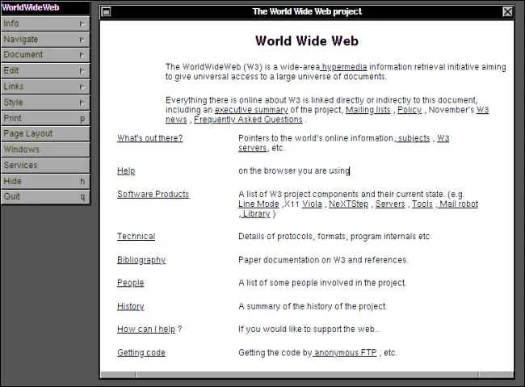
Innovation

Slide 8

Recognition

Slide 9
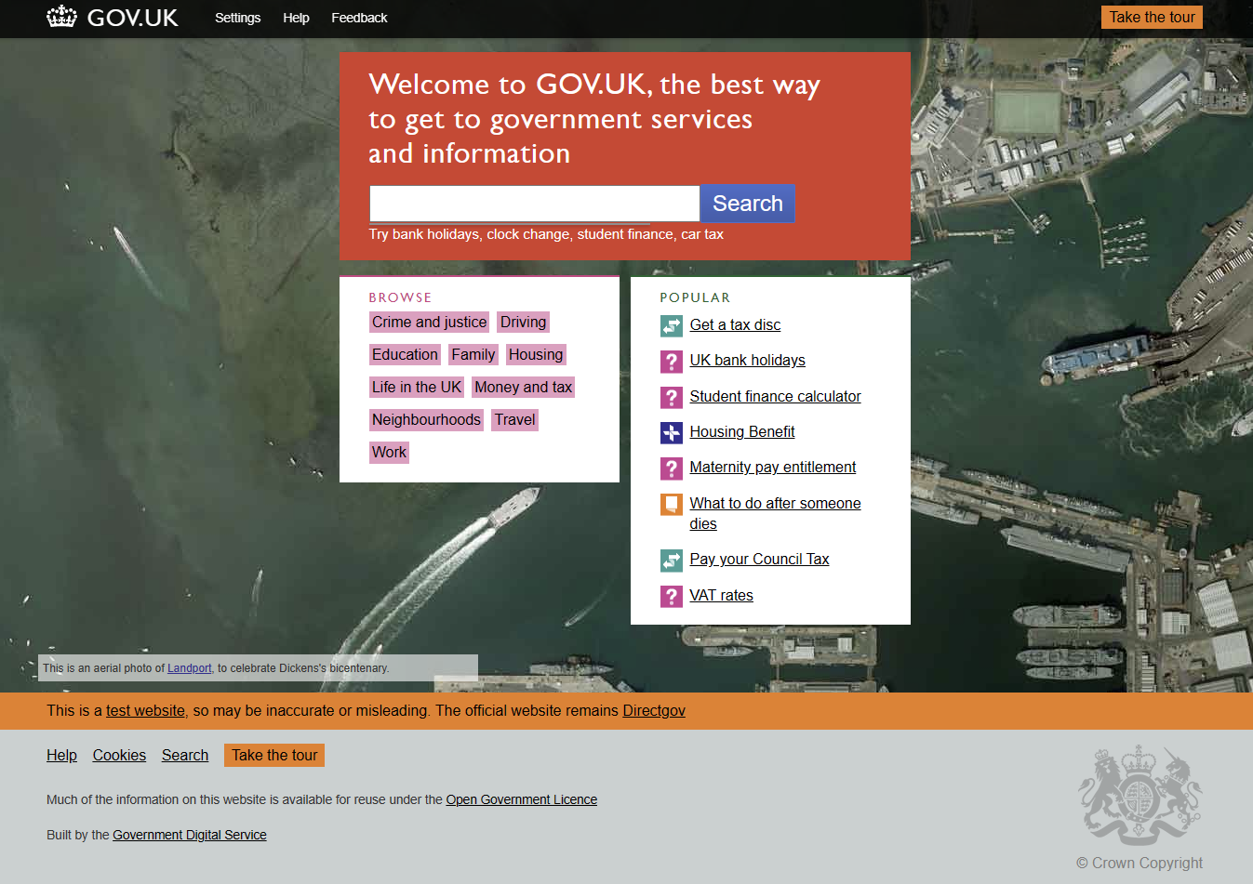
Experience

Slide 10
Why we choose voices

Slide 11


Innovation

Slide 12

Recognition

Slide 13

Experience

Slide 14
Why we need CSS Speech

Slide 15
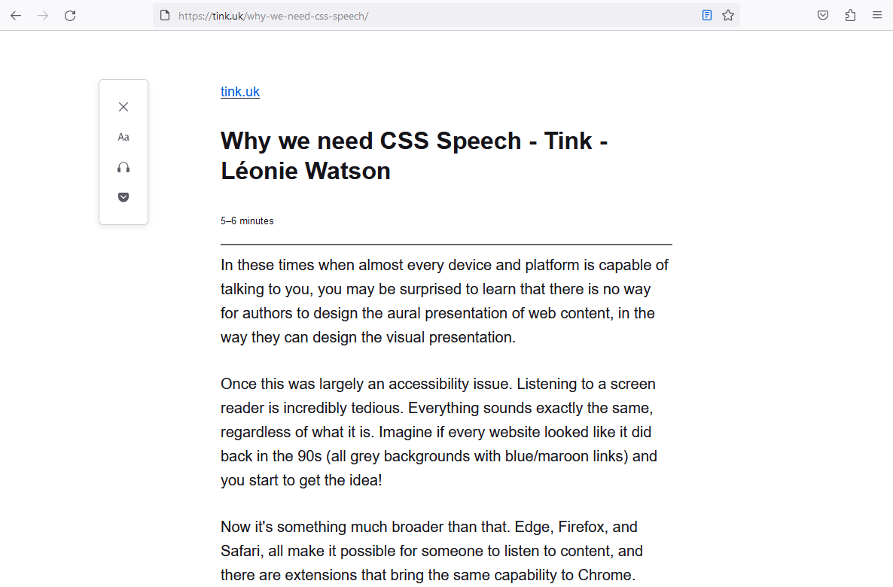
Innovation

Slide 16

Recognition

Slide 17

Experience

Slide 18
About CSS Speech

Slide 19
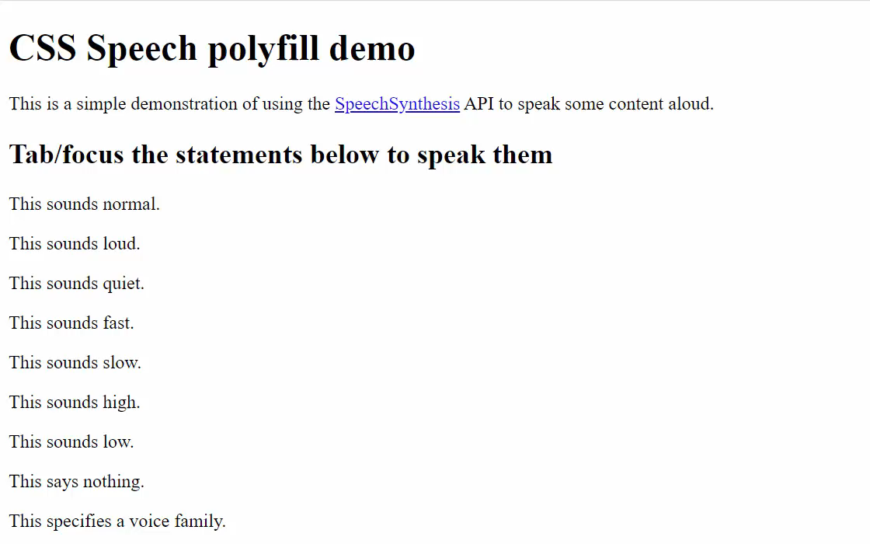
Innovation

Slide 20
Recognition
#display {
font-family: Arial, Helvetica, sans-serif;
color: #fff;
background-color: #000;
font-size: medium;
}
#speak {
voice-family: "Google UK English Female", "Samantha";
voice-volume: medium;
voice-rate: fast;
voice-pitch: high;
}

Slide 21
Experience

Slide 22
Where you find more information

Slide 23
CSS Speech specification
https://www.w3.org/TR/css-speech-1/

Slide 24
Blog posts
Why we need CSS Speech:
https://tink.uk/why-we-need-css-speech/
Addressing concerns about CSS Speech:
https://tink.uk/addressing-concerns-about-css-speech/

Slide 25
Polyfill demo
https://www.kryogenix.org/code/browser/css-speech-polyfill/css-speech.html

Slide 26
Voices database
https://speech-api-voices-gatherer.glitch.me/

Slide 27
Why we need CSS Speech
Thank you

